Slide 1

Data Bases
NTI
Data Analysis

Slide 2
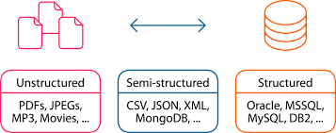
These are the three types of data types which lead directly to the type of the data repository where such data type can be extracted, transformed, and loaded into. Structured data such as EXCEL files, ACCESS databases, SQL databases, and every type of databases that constructed from rows and columns. Semi-structured data such as Emails where the sender, carbon copy recipient, blinded carbon copy recipient, and subject fields are structured data where the email content is not structured data. Unstructured data such as videos, images, text files, audio, etc.
Data Types

Slide 3
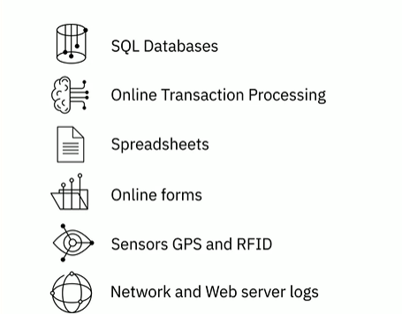

Structured Data

Slide 4

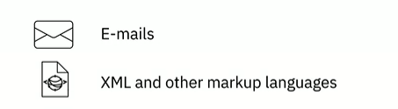
Semi-Structured Data

Slide 5
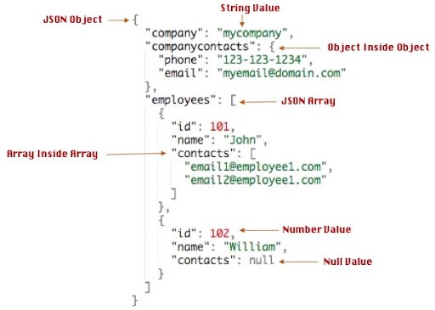
Semi-Structured Data

Slide 6
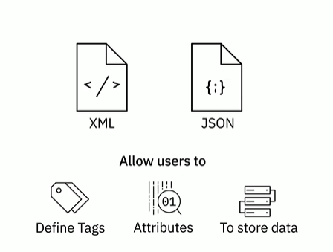
Semi-Structured Data

Slide 7
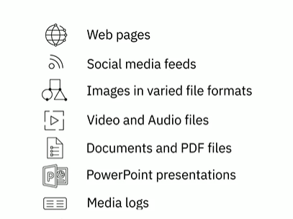

Unstructured Data

Slide 8
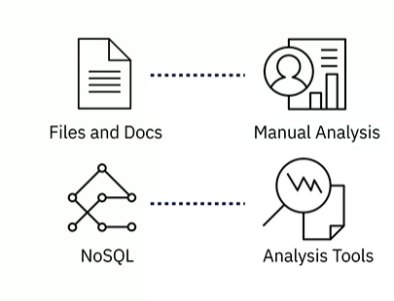
Unstructured Data

Slide 9
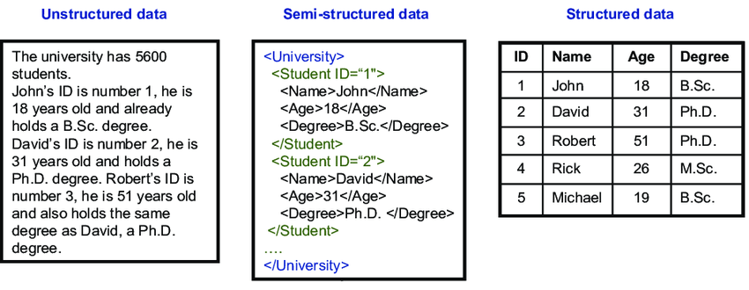

Slide 10
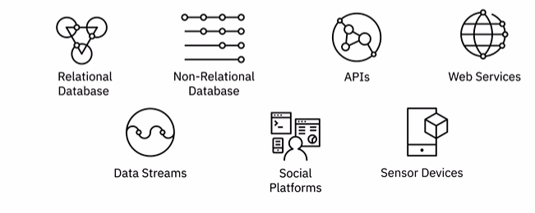
Data
Data can come in a variety of file formats, such as :

Slide 11
Standard File Format
1. Delimited text file formats, or .CSV
2. Microsoft Excel Open .XML Spreadsheet, or .XLSX
3. Extensible Markup Language, or .XML
4. Portable Document Format, or .PDF
5. JavaScript Object Notation, or .JSON

Slide 12
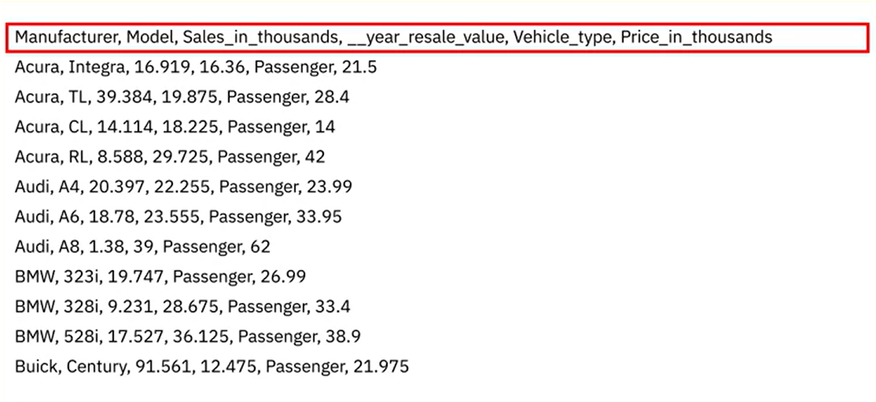

Slide 13
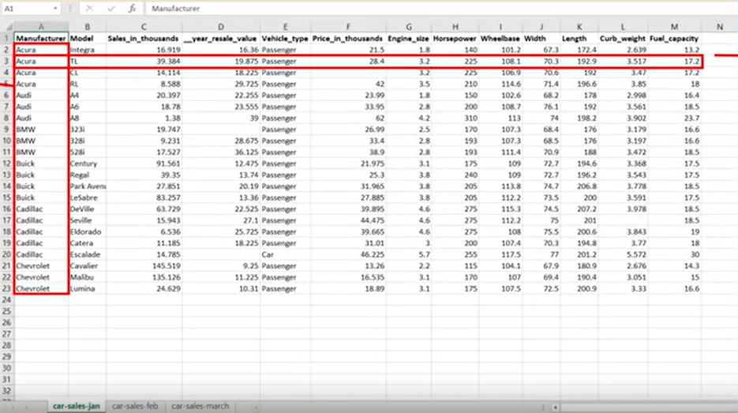
Column
ROW

Slide 14
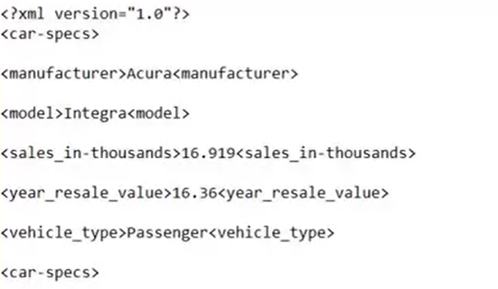
Extensible Markup Language or .XML
is a markup language with set rules for encoding data.
Readable by both humans and machines
Self-descriptive language
Similar to .HTML in some respects
Does not use predefined tags like .HTML does
Platform independent
Programming language independent
Makes it simpler to share data between systems

Slide 15
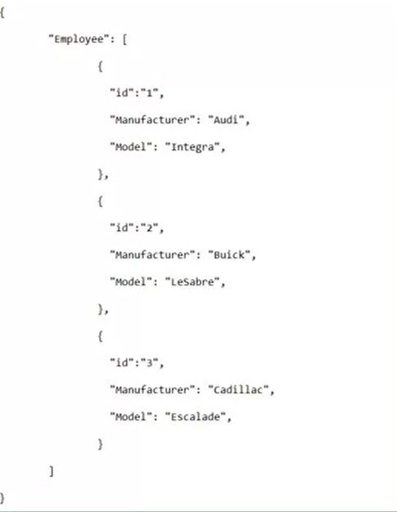
JavaScript Object Notation or JSON
is a text-based open standard designed for transmitting structured data over the web.
Language-independent data format
Can be read in any programming language
Easy to use
Compatible with a wide range of browsers
Considered as one of the best tools for sharing data

Slide 16

Query Language
Programming Language
Shell Scraping
Query languages are designed for accessing and manipulating data in a database (SQL)
Programming languages are designed for developing applications and controlling application behavior (Python, R, Java)
Shell and Scripting languages are ideal for repetitive and time-consuming operational tasks (Unix/Linux Shell, PowerShell)

Slide 17
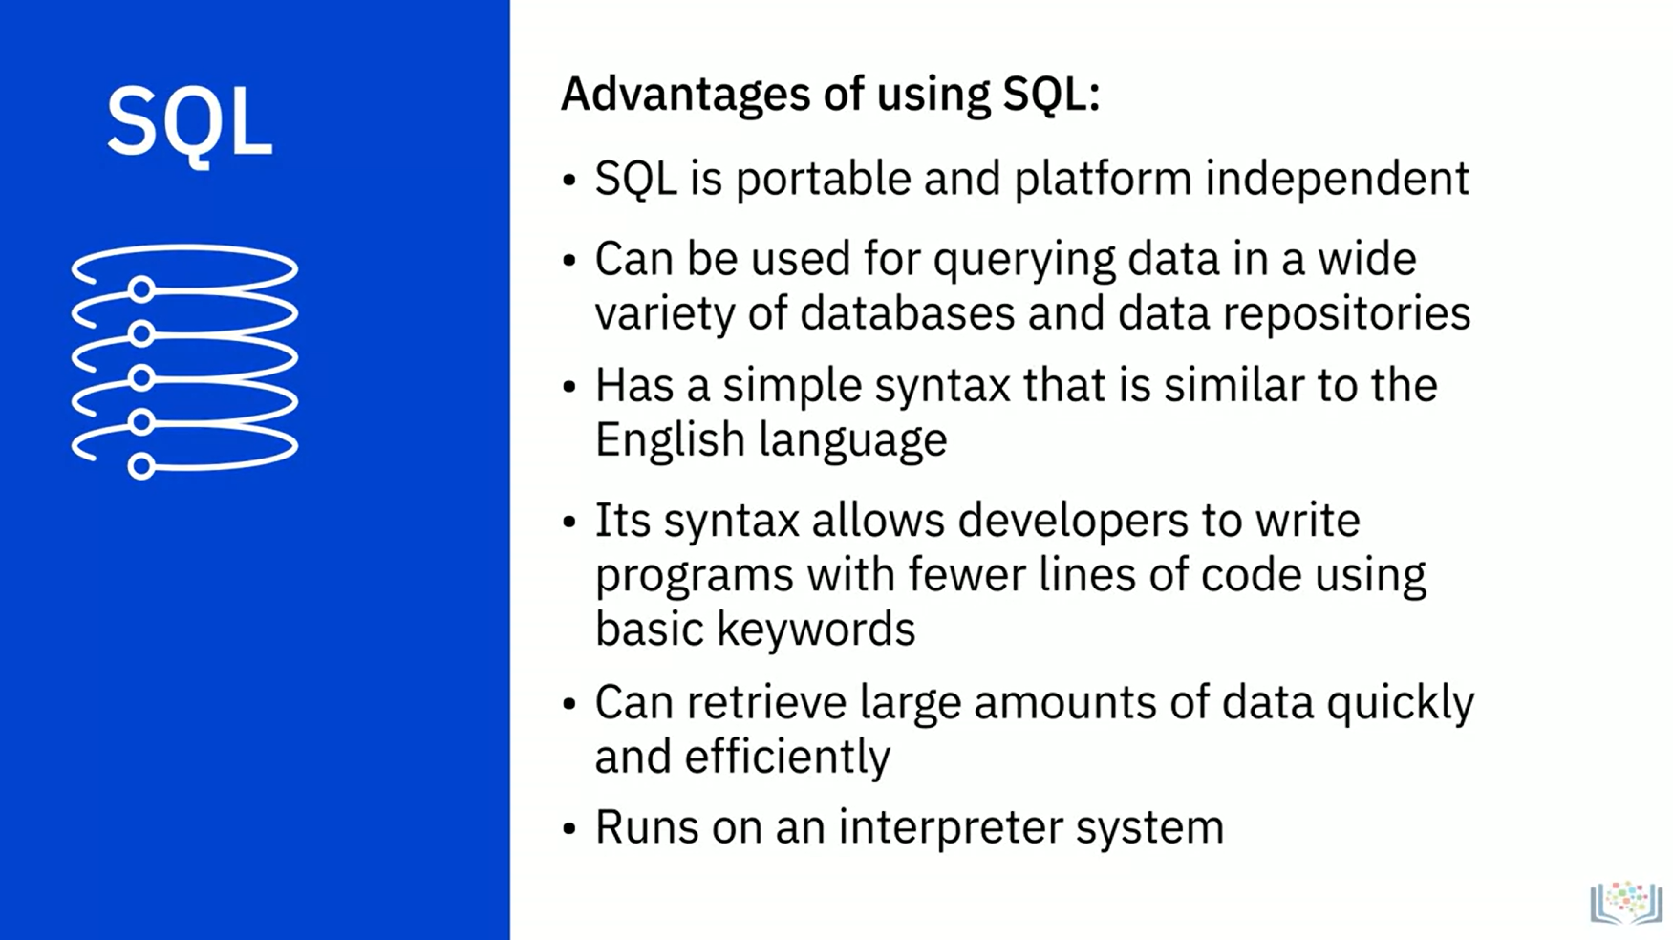
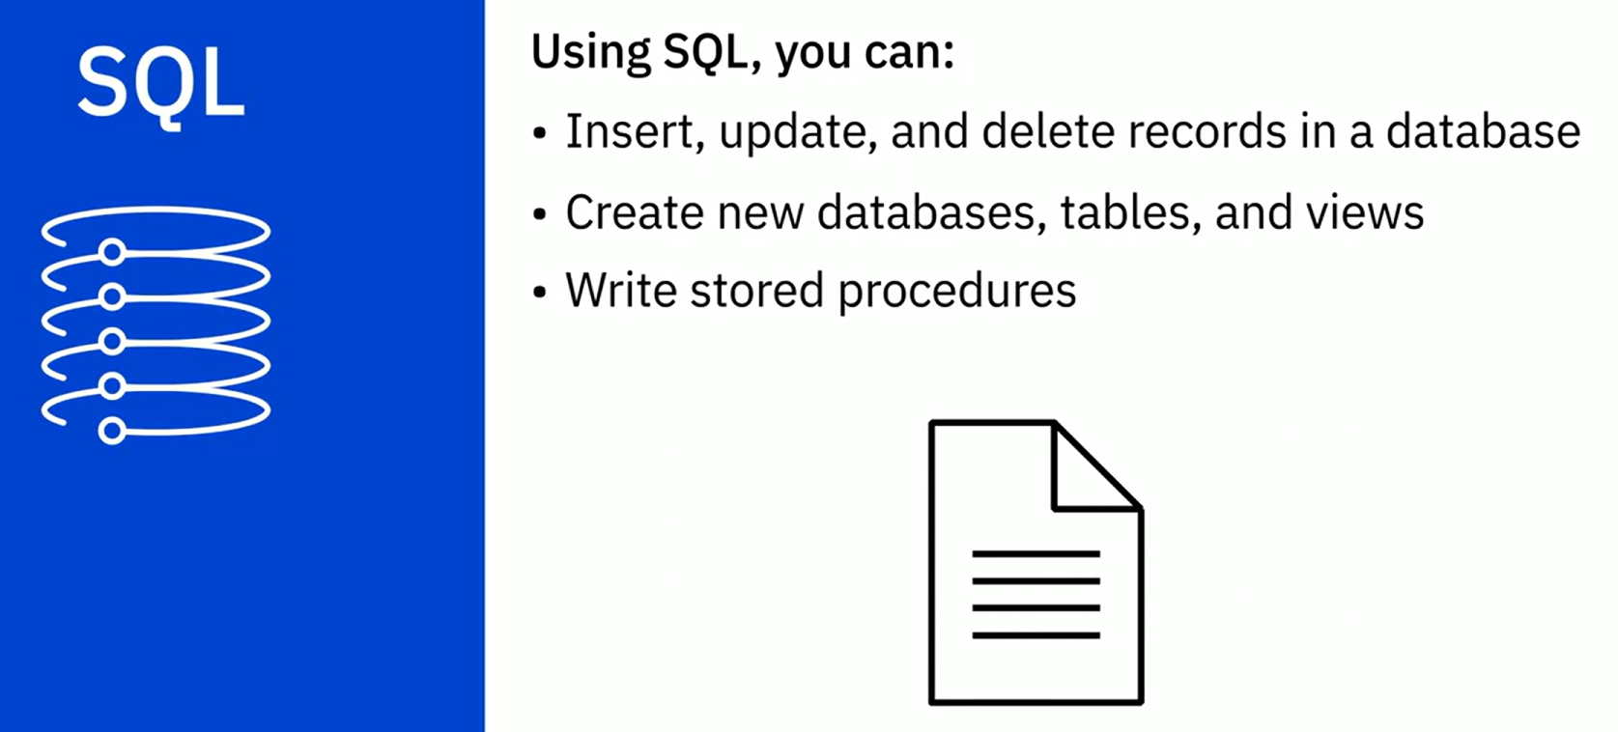
Structured Query Language

Slide 18

Types of data repositories include:
Databases
Data Warehouses
Big Data Stores

Slide 19
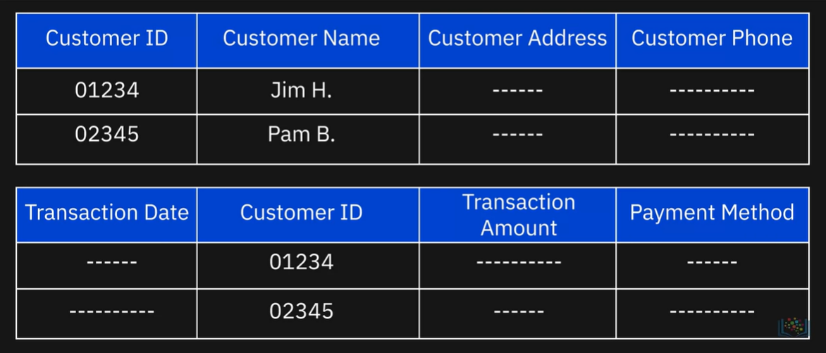
What is Relational Database?

Slide 20
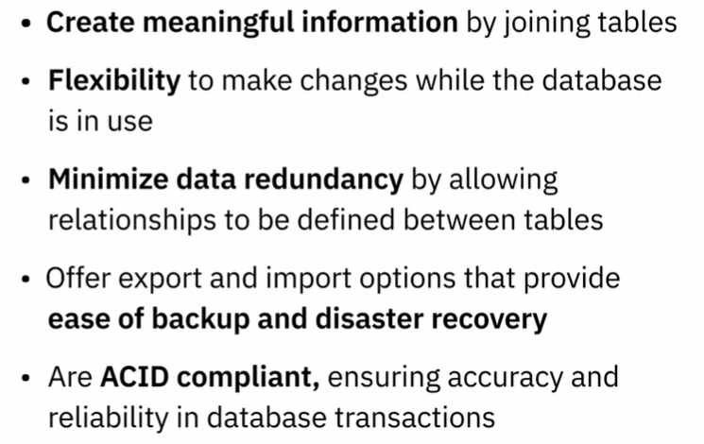

Advantage of Relational Databases

Slide 21
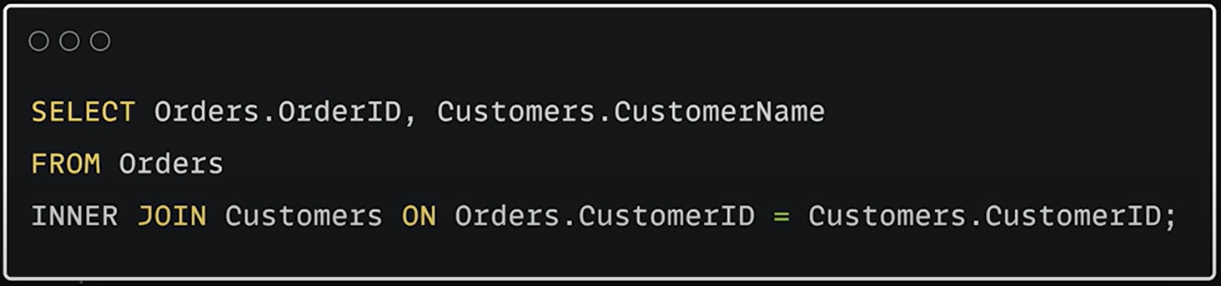
Structured Query Language

Slide 22
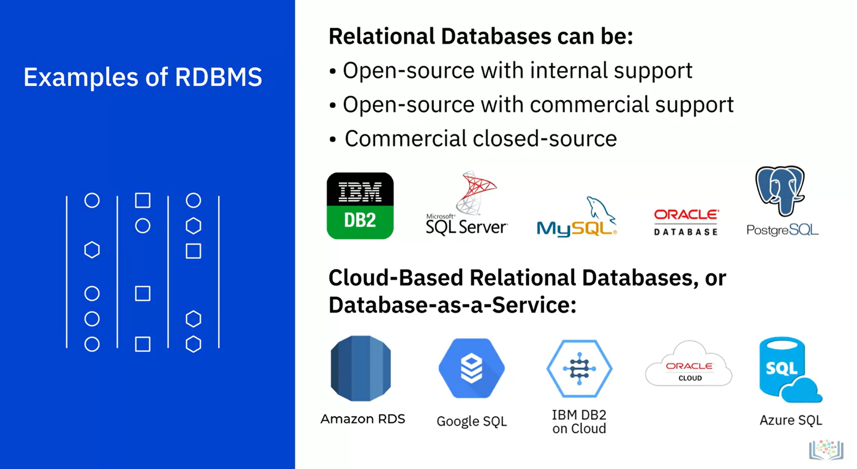
Examples of RDBMS

Slide 23
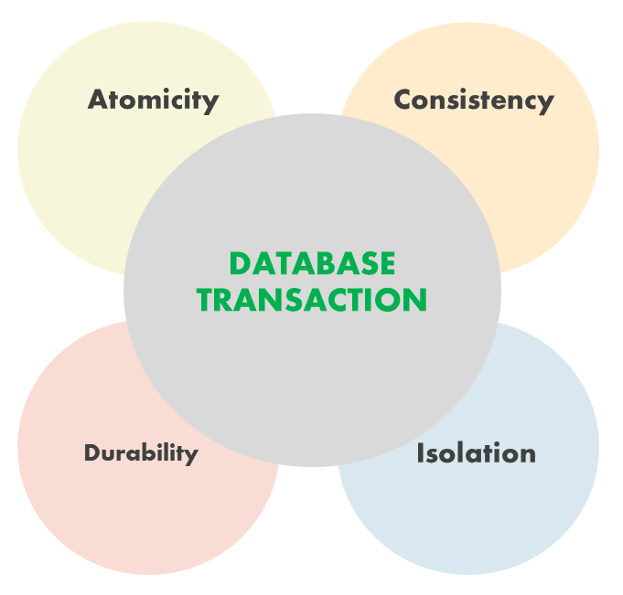

Slide 24

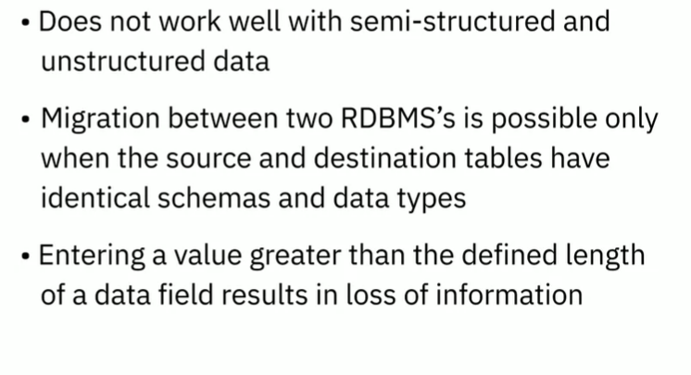
Limitations of RDBMS

Slide 25
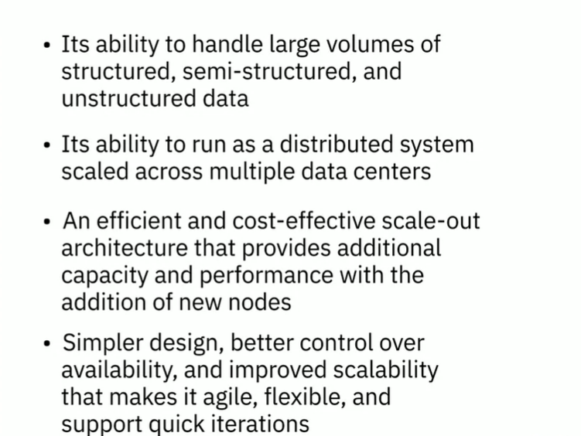
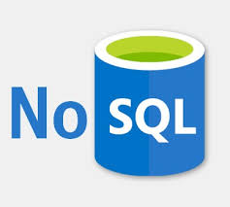
Advantage of NoSQL

Slide 26
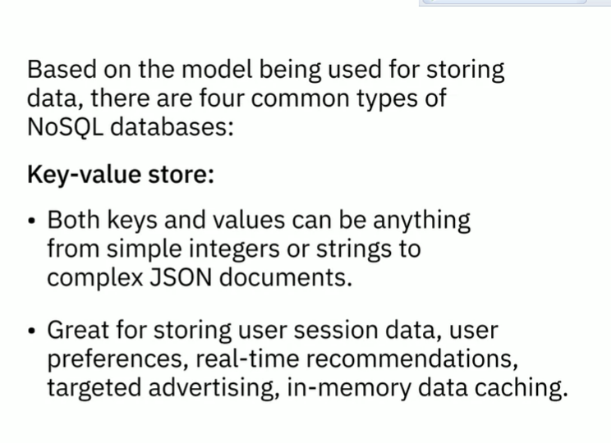
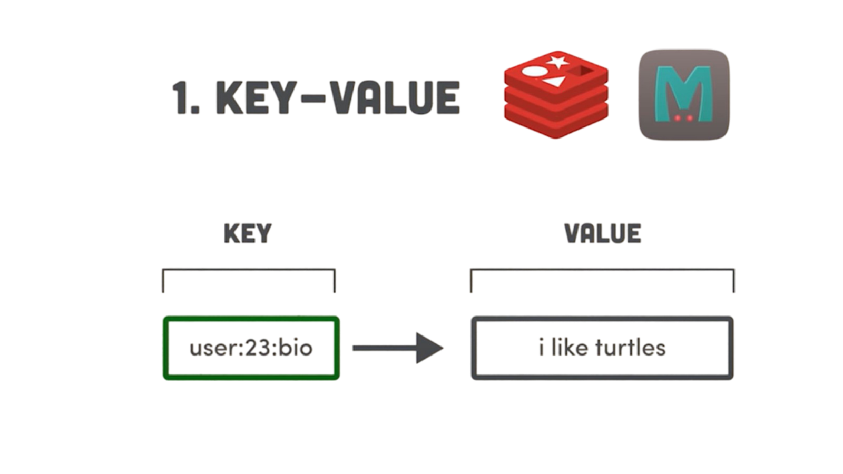
Key-Value Store

Slide 27
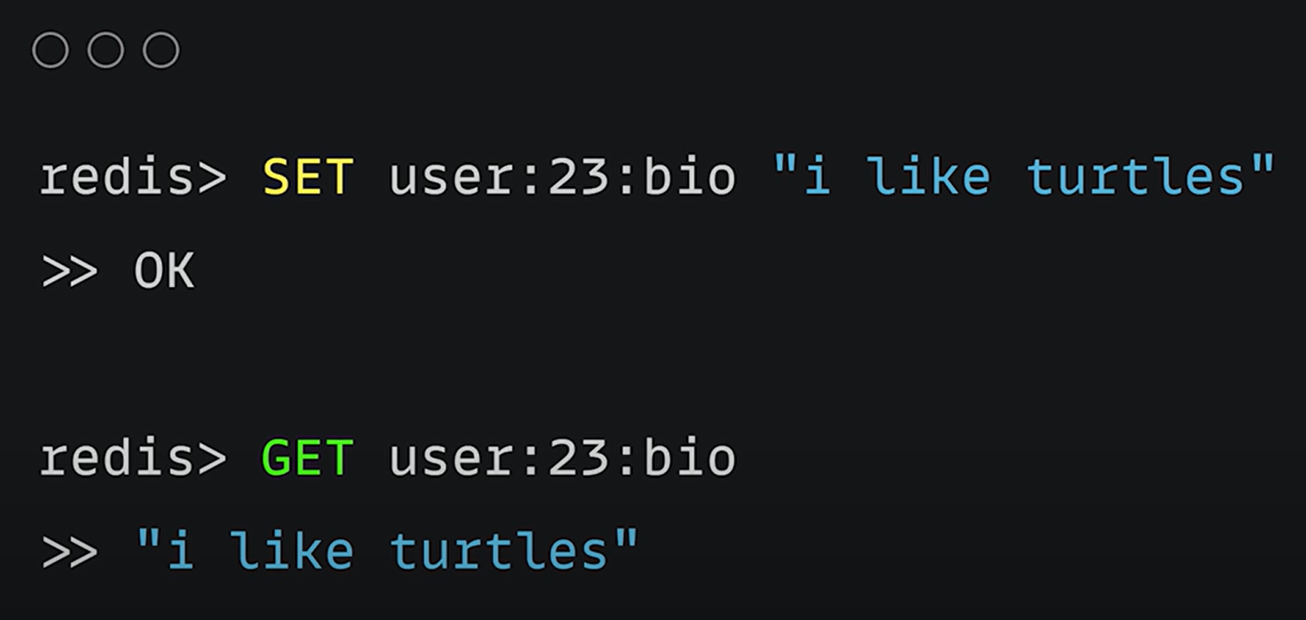

Slide 28
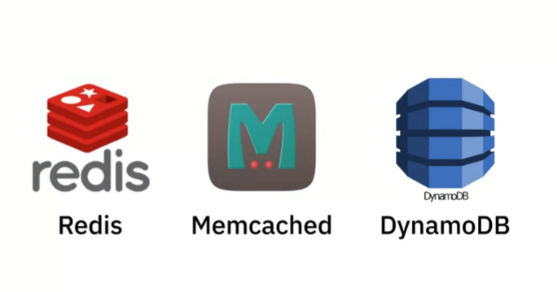
Key-Value Store

Slide 29
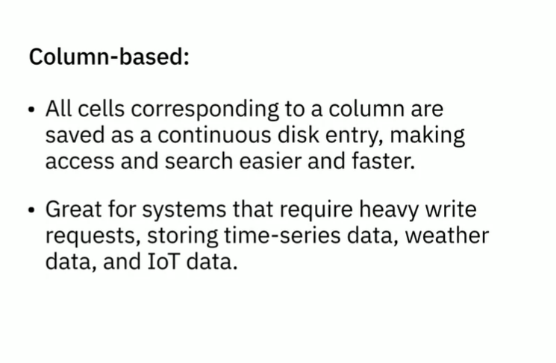

Column Based

Slide 30
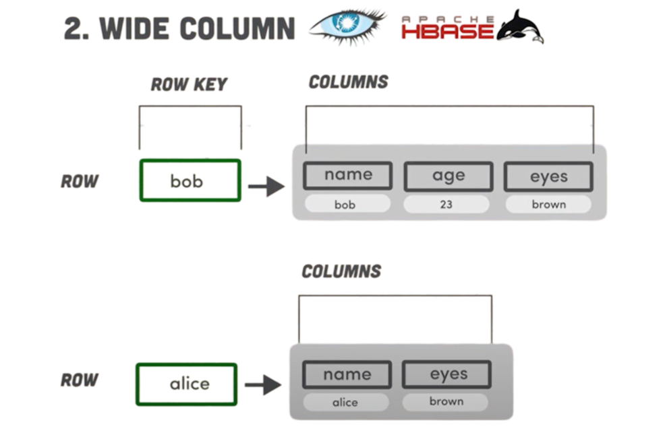

Slide 31
Column Based

Slide 32

Column Based

Slide 33
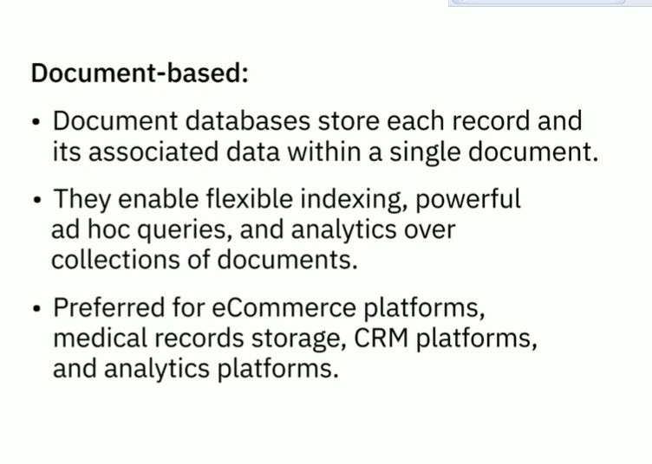

Document Based

Slide 34
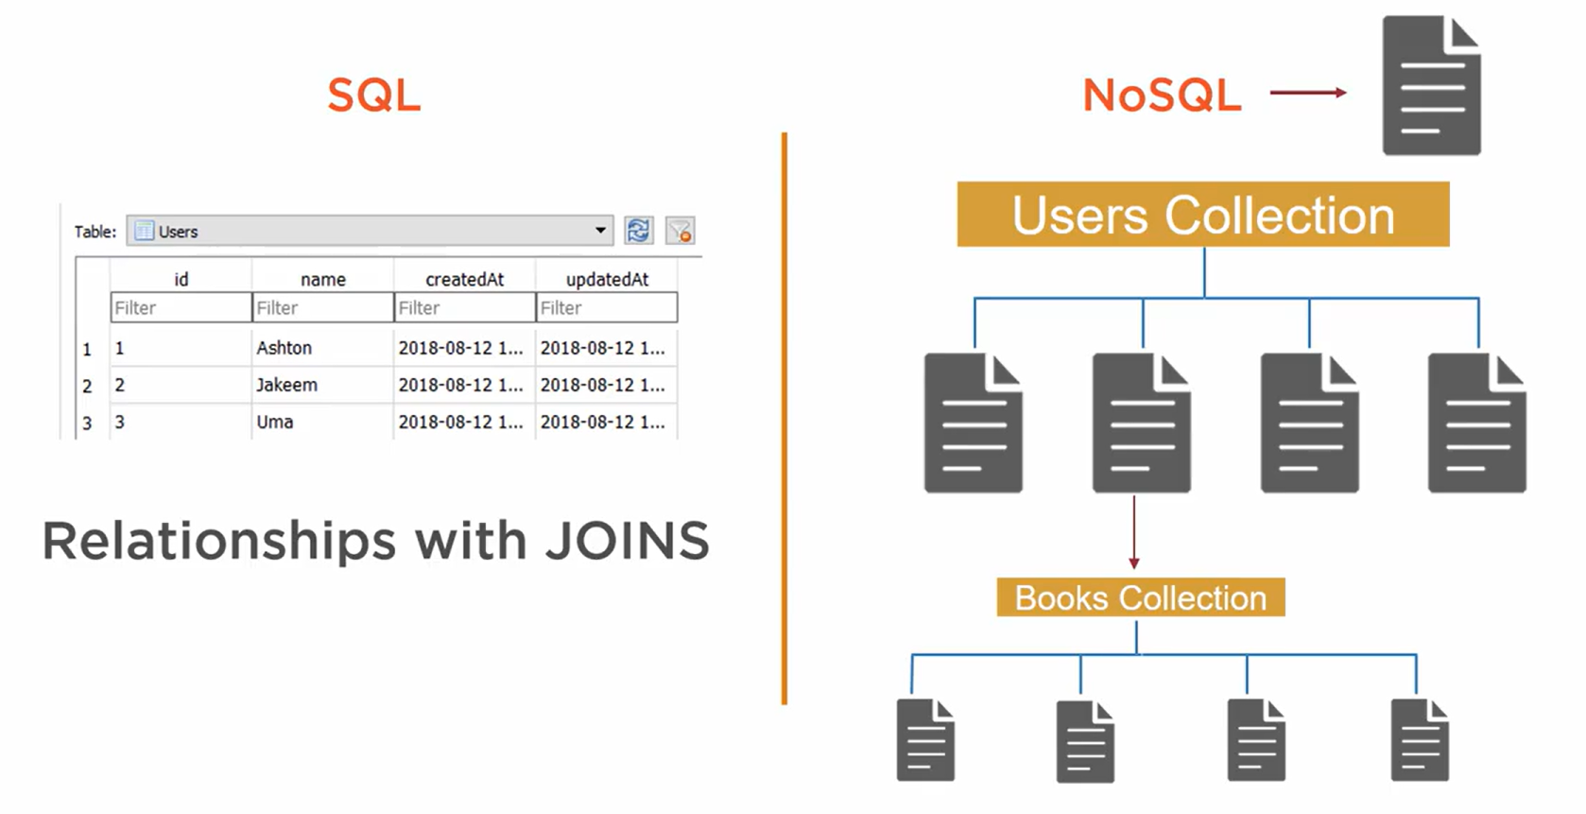

Slide 35
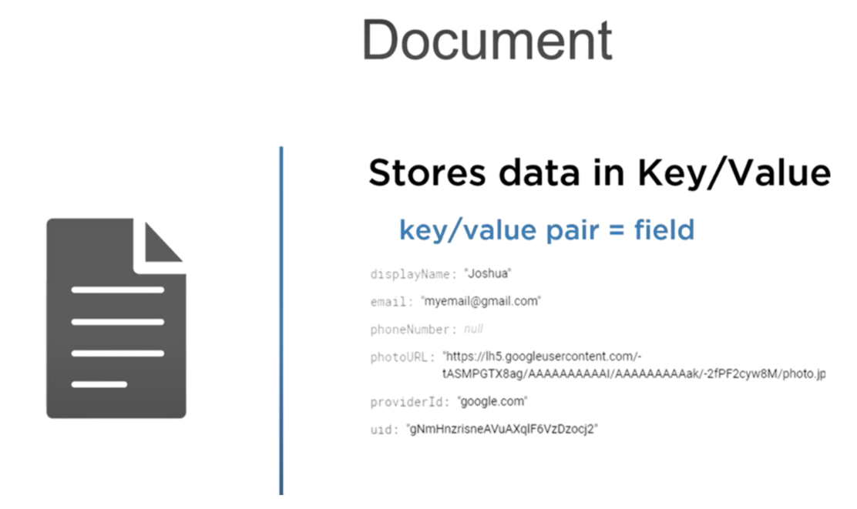

Slide 36
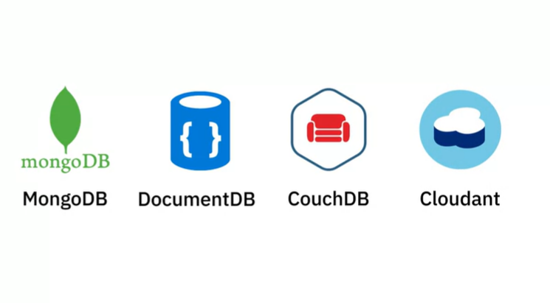
Document Based

Slide 37
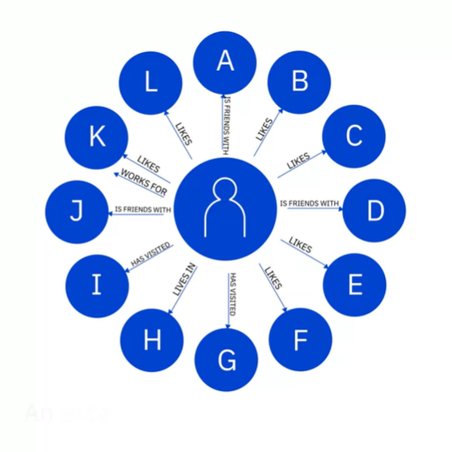

Graph Based

Slide 38
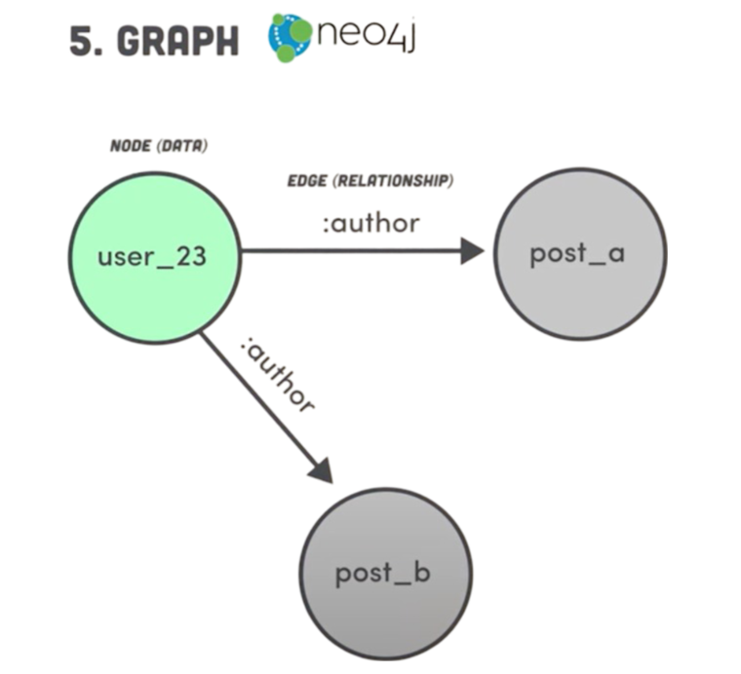

Slide 39
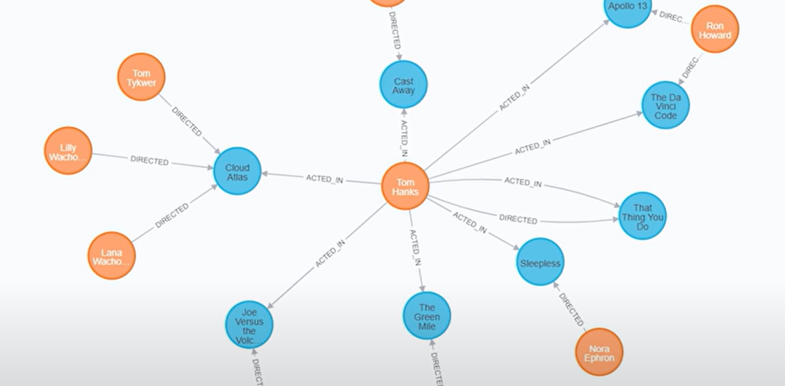

Slide 40
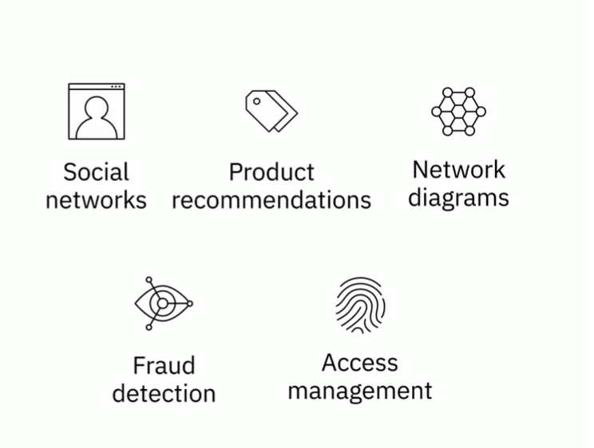
Graph Based

Slide 41
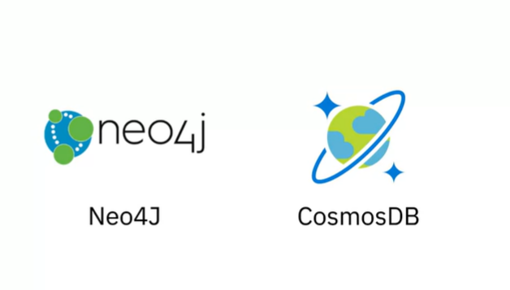
Graph Based

Slide 42

Data Warehouse
NTI
Data Analysis

Slide 43
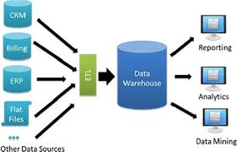
Data Warehouses
Data warehouse is the location where we store the ready for analysis data coming from multiple operations systems in the organization. How does it be ready for analysis? using the ETL framework to transform the data from being raw data into being a ready for analysis data. Then we can push the specific data into reporting, analytics, or data mining services in the organization.

Slide 44
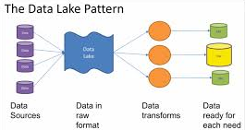
Data Marts
So, we should have a pool of data to store all types and formats of data as a transition phase, this pool called Data Lake. After collecting all the data in raw format we can use ETL framework to transform data into ready for analysis data and store it inside data marts and data warehouses. Then we can get ready for analysis data from both of them.

Slide 45
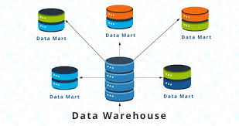
Data Lakes
Data Mart is a magic, we can use it for security and performance isolation. We can dedicate a mart for sales team, for marketing team, for operations team, and so on.

Slide 47
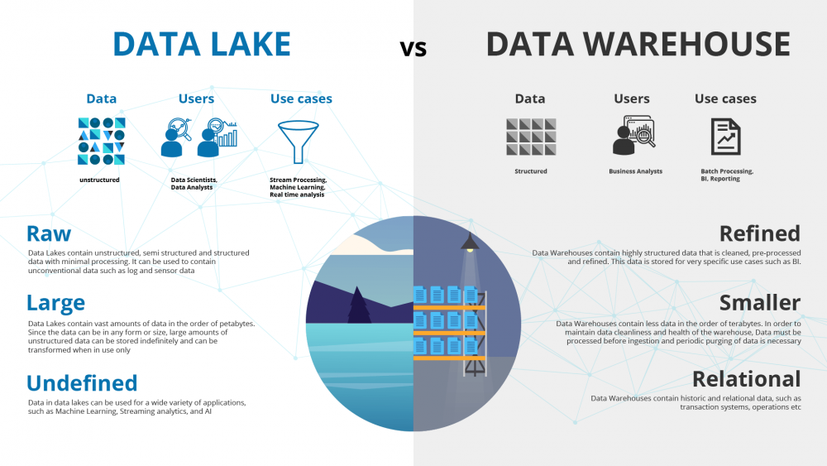
47

Slide 48
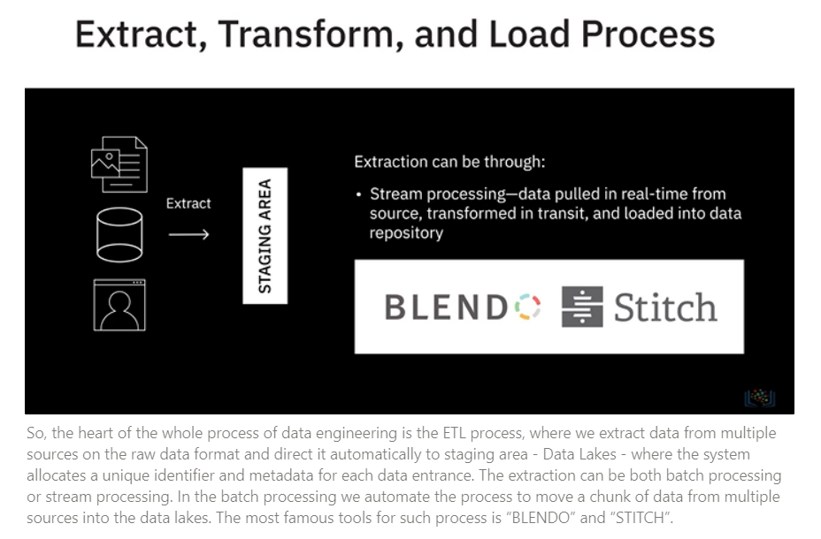
Extract, Transform, and Load (ETL) Process
Batch
So, the heart of the whole process of data engineering is the ETL process, where we extract data from multiple sources on the raw data format and direct it automatically to staging area - Data Lakes - where the system allocates a unique identifier and metadata for each data entrance. The extraction can be both batch processing or stream processing. In the batch processing we automate the process to move a chunk of data from multiple sources into the data lakes. The most famous tools for such process is "BLENDO" and "STITCH".

Slide 49
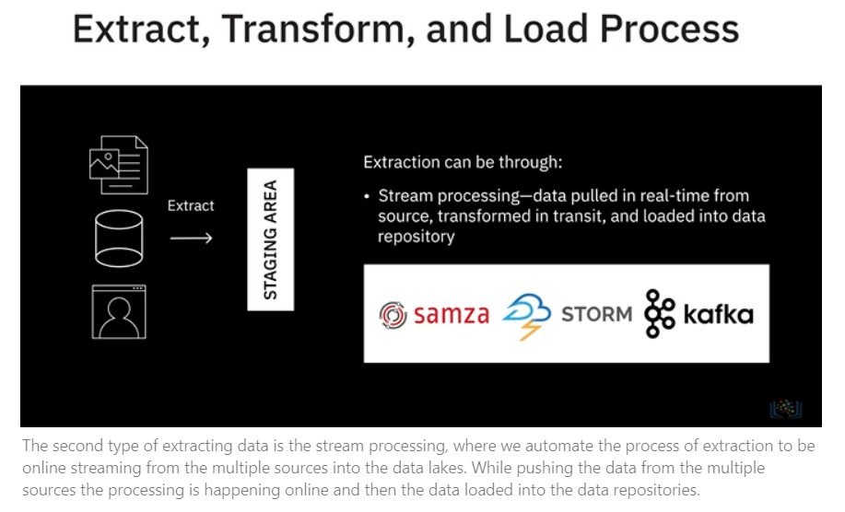
Extract, Transform, and Load (ETL) Process
The second type of extracting data is the stream processing, where we automate the process of extraction to be online streaming from the multiple sources into the data lakes. While pushing the data from the multiple sources the processing is happening online and then the data loaded into the data repositories.

Slide 50
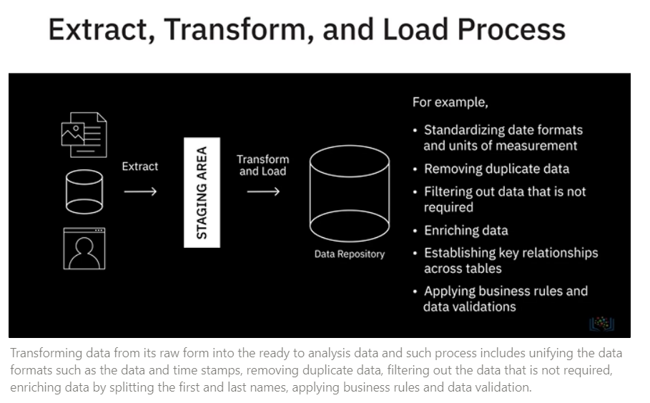
Extract, Transform, and Load (ETL) Process
Transforming data from its raw form into the ready to analysis data and such process includes unifying the data formats such as the data and time stamps, removing duplicate data, filtering out the data that is not required, enriching data by splitting the first and last names, applying business rules and data validation.

Slide 51
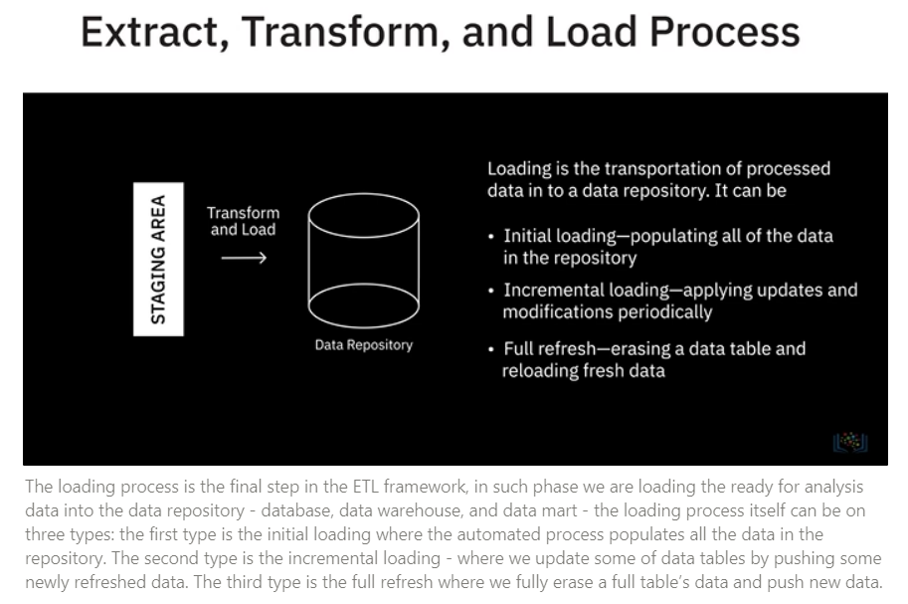
Extract, Transform, and Load (ETL) Process
The loading process is the final step in the ETL framework, in such phase we are loading the ready for analysis data into the data repository - database, data warehouse, and data mart - the loading process itself can be on three types: the first type is the initial loading where the automated process populates all the data in the repository. The second type is the incremental loading - where we update some of data tables by pushing some newly refreshed data. The third type is the full refresh where we fully erase a full table's data and push new data.

Slide 52
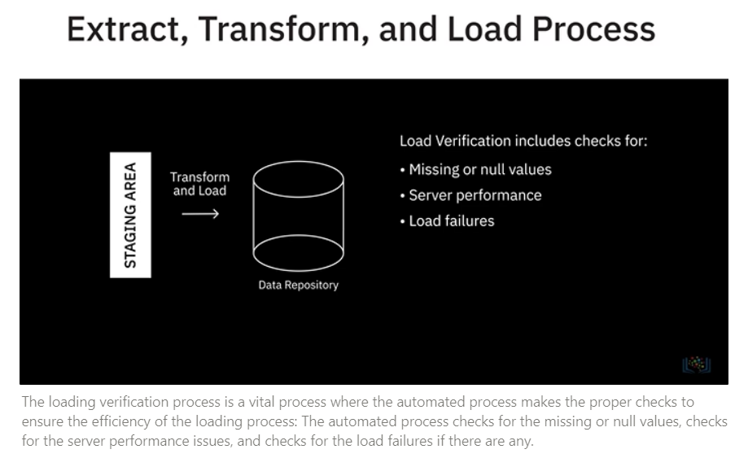
Extract, Transform, and Load (ETL) Process
The loading verification process is a vital process where the automated process makes the proper checks to ensure the efficiency of the loading process: The automated process checks for the missing or null values, checks for the server performance issues, and checks for the load failures if there are any.

Slide 53



Data Pipeline
A Data Pipeline
Can be used for both batch and streaming data
Supports both long-running batch queries and smaller interactive queries
Typically loads data into a data lake but can also load data into a variety of target destinations-including other applications and visualization tools

Slide 54
Discussion
NTI
Data Analysis

Slide 55
Question 1
Data Marts and Data Warehouses have typically been relational, but the emergence of what technology has helped to let these be used for non-relational data?
SQL
ETL
NoSQL
Data Lake

Slide 56
Question 2
What is one of the most significant advantages of an RDBMS?
Enforces a limit on the length of data fields
Can store only structured data
Requires source and destination tables to be identical for migrating data
Is ACID-Compliant

Slide 57
Question 3
Which one of the NoSQL database types uses a graphical model to represent and store data, and is particularly
useful for visualizing, analyzing, and finding connections between different pieces of data?
Column-based
Document-based
Graph-based
Key value store

Slide 58
Question 4
Which of the data repositories serves as a pool of raw data and stores large amounts of structured, semi- structured, and unstructured data in their native formats?
Data Lakes
Data Marts
Data Warehouses
Relational Databases

Slide 59
Questions
NTI
Data Analysis

Slide 60
Thank You.
NTI
Mennatullah Elsahy
Data Analysis
01064257910
mennatullahelsahy@gmail.com
Mennatullah Elsahy | LinkedIn

